Slide 1
Java Script
client-side programming with JavaScript
  scripts vs. programs
    JavaScript vs. JScript vs. VBScript
    common tasks for client-side scripts
  JavaScript
    data types & expressions
    control statements
    functions & libraries
    strings & arrays

Slide 2
PREREQUISITES
Before you continue you should have a basic understanding of the following:
Basic Concept of Web Application
Basic Concept of Web Programming
Basic Concept of Web Technology
HTML
CSS

Slide 3
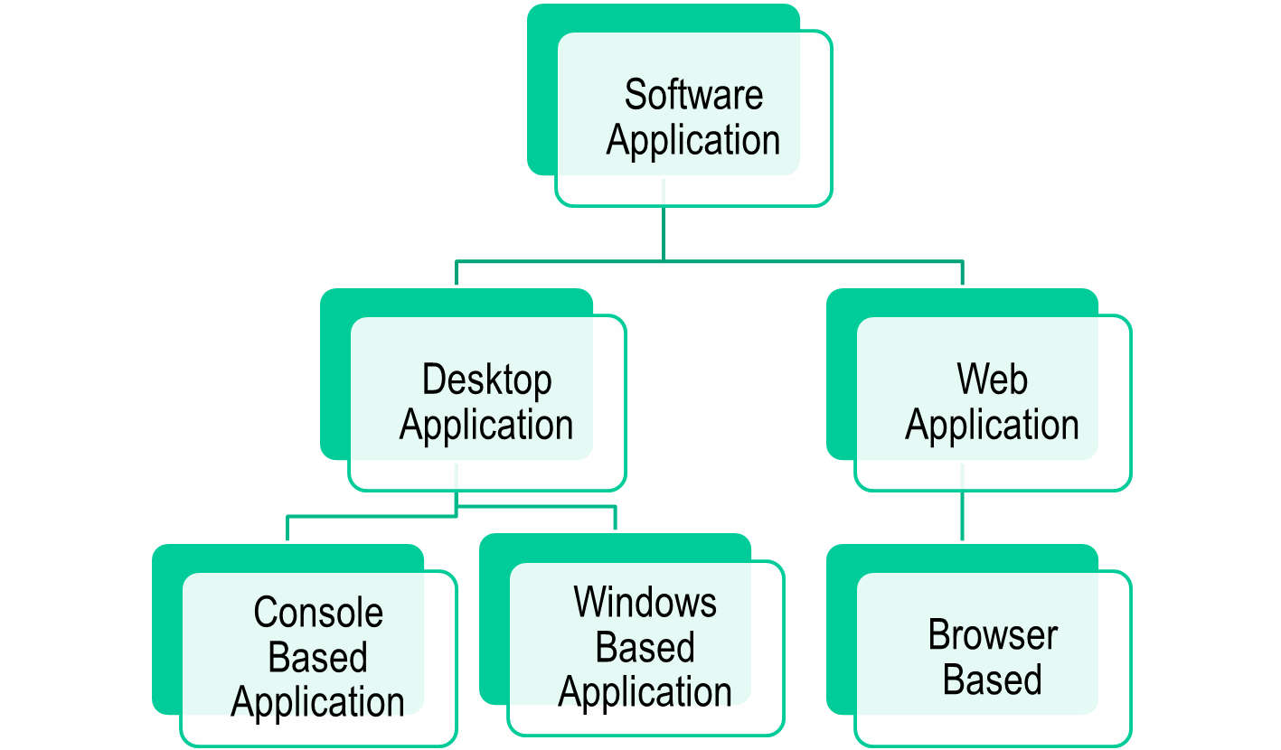
Target
Drivers
Compiler
Robot etc
Target
MIS Applications
Target
WebSite
Portal
WAPSite

Slide 4
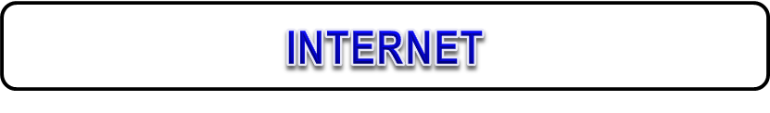




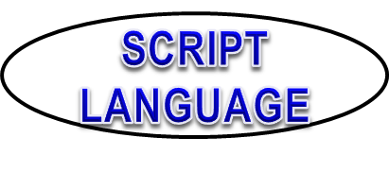



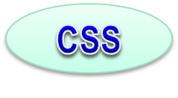

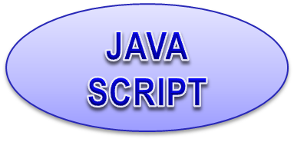

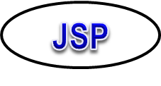

Slide 5
Java Script
JavaScript is most commonly used as a client side scripting language.
Javascript is a scripting language that will allow you to add real programming to your webpages.
You can create small application type processes with javascript, like a calculator or a primitive game of some sort.

Slide 6
Java Script
Since javascript isn't HTML, you will need to let the browser know in advance when you enter javascript to an HTML page. This is done using the <script> tag.
The browser will use the <script> type="text/javascript"> and </script> to tell where javascript starts and ends.

Slide 7
Example
<html> <head> <title>My Javascript Page</title> </head> <body> <script type="text/javascript"> alert("Welcome to my world!!!"); </script> </body> </html>

Slide 8
Java Script
The word alert is a standard javascript command that will cause an alert box to pop up on the screen. The visitor will need to click the "OK" button in the alert box to proceed.
By entering the alert command between the
<script type="text/javascript"> and </script> tags, the browser will recognize it as a javascript command.
If we had not entered the <script> tags, the browser would simply recognize it as pure text, and just write it on the screen.
You can enter javascript in both the <head> and <body> sections of the document.
In general however, it is advisable to keep as much as possible in the <head>section.

Slide 9
Client-Side Programming
HTML is good for developing static pages
  can specify text/image layout, presentation, links, …
  Web page looks the same each time it is accessed
  in order to develop interactive/reactive pages, must integrate programming in some form or another
client-side programming
  programs are written in a separate programming (or scripting) language
    e.g., JavaScript, JScript, VBScript
  programs are embedded in the HTML of a Web page, with (HTML) tags to identify the program component
    e.g., <script type="text/javascript"> … </script>
  the browser executes the program as it loads the page, integrating the dynamic output of the program with the static content of HTML
  could also allow the user (client) to input information and process it, might be used to validate input before it’s submitted to a remote server

Slide 10
Scripts vs. Programs
a scripting language is a simple, interpreted programming language
  scripts are embedded as plain text, interpreted by application
  simpler execution model: don't need compiler or development environment
  saves bandwidth: source code is downloaded, not compiled executable
  platform-independence: code interpreted by any script-enabled browser
  but: slower than compiled code, not as powerful/full-featured
  JavaScript: the first Web scripting language, developed by Netscape in 1995
  syntactic similarities to Java/C++, but simpler, more flexible in some respects,
  limited in others
      (loose typing, dynamic variables, simple objects)
  JScript: Microsoft version of JavaScript, introduced in 1996
    same core language, but some browser-specific differences
    fortunately, IE, Netscape, Firefox, etc. can (mostly) handle both
    JavaScript & JScript
    JavaScript 1.5 & JScript 5.0 cores both conform to ECMAScript standard
  VBScript: client-side scripting version of Microsoft Visual Basic

Slide 11
Common Scripting Tasks
adding dynamic features to Web pages
  validation of form data (probably the most commonly used application)
  image rollovers
  time-sensitive or random page elements
  handling cookies
  Ajax adds ability to update page elements without (re)loading a webpage
defining programs with Web interfaces
  utilize buttons, text boxes, clickable images, prompts, etc
limitations of client-side scripting
  since script code is embedded in the page, it is viewable to the world
  for security reasons, scripts are limited in what they can do
    e.g., can't access the client's hard drive
  since they are designed to run on any machine platform, scripts do not contain platform specific commands
  script languages are not full-featured
    e.g., JavaScript objects are very crude, not good for large project development

Slide 12
JavaScript
JavaScript code can be embedded in a Web page using <script> tags
  the output of JavaScript code is displayed as if directly entered in HTML
<html>
<!–- COMP519 js01.html 16.08.06 -->
<head>
<title>JavaScript Page</title>
</head>
<body>
<script type="text/javascript">
// silly code to demonstrate output
document.write("<p>Hello world!</p>");
document.write(" <p>How are <br/> " +
" <i>you</i>?</p> ");
</script>
<p>Here is some static text as well.</p>
</body>
</html>
document.write displays text in the page
  text to be displayed can include HTML tags
  the tags are interpreted by the browser as normal when the text is displayed
as in C++/Java, statements end with ;
but a line break might also be interpreted as the end of a statement (depends upon browser)
JavaScript comments similar to C++/Java
  // starts a single line comment
  /*…*/ enclose multi-line comments
view page

Slide 13
JavaScript Data Types & Variables
JavaScript has only three primitive data types
  String : "foo" 'how do you do?' "I said 'hi'." ""
  Number: 12 3.14159 1.5E6
  Boolean : true false (Null, Undefined have special meaning in JavaScipt)
assignments are as in C++/Java
  message = "howdy";
  pi = 3.14159;
variable names are sequences of letters, digits, and underscores that start with a letter or an underscore
variables names are case-sensitive
you don't have to declare variables, will be created the first time used, but it’s better if you use var statements (because of scoping issues)
var message, pi=3.14159;
variables are loosely typed, can be assigned different types of values (Danger!)
<html>
<!–- COMP519 js02.html 16.08.06 -->
<head>
<title>Data Types and Variables</title>
</head>
<body>
<script type="text/javascript">
var x, y;
x= 1024;
y=x; x = "foobar";
document.write("<p>x = " + y + "</p>");
document.write("<p>x = " + x + "</p>");
</script>
</body>
</html>
view page

Slide 14
Date Object
String & Array are the most commonly used objects in JavaScript
  other, special purpose objects also exist
for example, the Date object can be used to access the date and time, and to perform "date arithmetic"
  to create a Date object, use new & supply year/month/day/… as desired
    today = new Date(); // sets to current date & time
    newYear = new Date(2002,0,1); //sets to Jan 1, 2002 12:00AM
  methods include:
    newYear.getYear() can access individual components of a date
    newYear.getMonth()
    newYear.getDay()
    newYear.getHours()
    newYear.getMinutes()
    newYear.getSeconds()
    newYear.getMilliseconds()

Slide 15
Date Example
<html>
<!–- COMP519 js11.html 16.08.2006 -->
<head>
<title>Time page</title>
</head>
<body>
Time when page was loaded:
<script type="text/javascript">
now = new Date();
document.write("<p>" + now + "</p>");
time = "AM";
hours = now.getHours();
if (hours > 12) {
hours -= 12;
time = "PM"
}
else if (hours == 0) {
hours = 12;
}
document.write("<p>" + hours + ":" +
now.getMinutes() + ":" +
now.getSeconds() + " " +
time + "</p>");
</script>
</body>
</html>
by default, a date will be displayed in full, e.g.,
  Sun Feb 03 22:55:20 GMT-0600 (Central Standard Time) 2002
can pull out portions of the date using the methods and display as desired
  here, determine if "AM" or "PM" and adjust so hour between 1-12
  10:55:20 PM
view page

Slide 16
document Object
Internet Explorer, Firefox, Opera, etc. allow you to access information about an HTML document using the document object
<html>
<!–- COMP519 js13.html 2.10.2012 -->
<head>
<title>Documentation page</title>
</head>
<body>
<table width="100%">
<tr>
<td><i>
<script type="text/javascript">
document.write(document.URL);
</script>
</i></td>
<td style="text-align: right;"><i>
<script type="text/javascript">
document.write(document.lastModified);
</script>
</i></td>
</tr>
</table>
</body>
</html>
document.write(…)
  method that displays text in the page
document.URL
  property that gives the location of the HTML document
document.lastModified
  property that gives the date & time the HTML document was last changed
view page

Slide 17
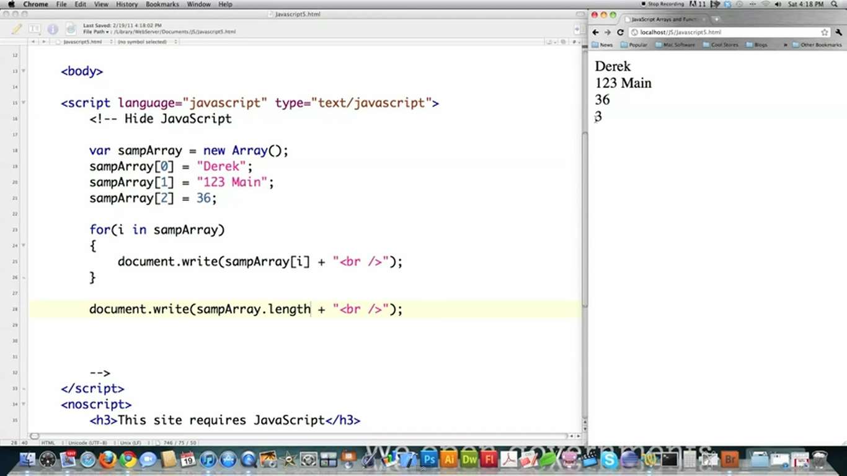

Slide 18
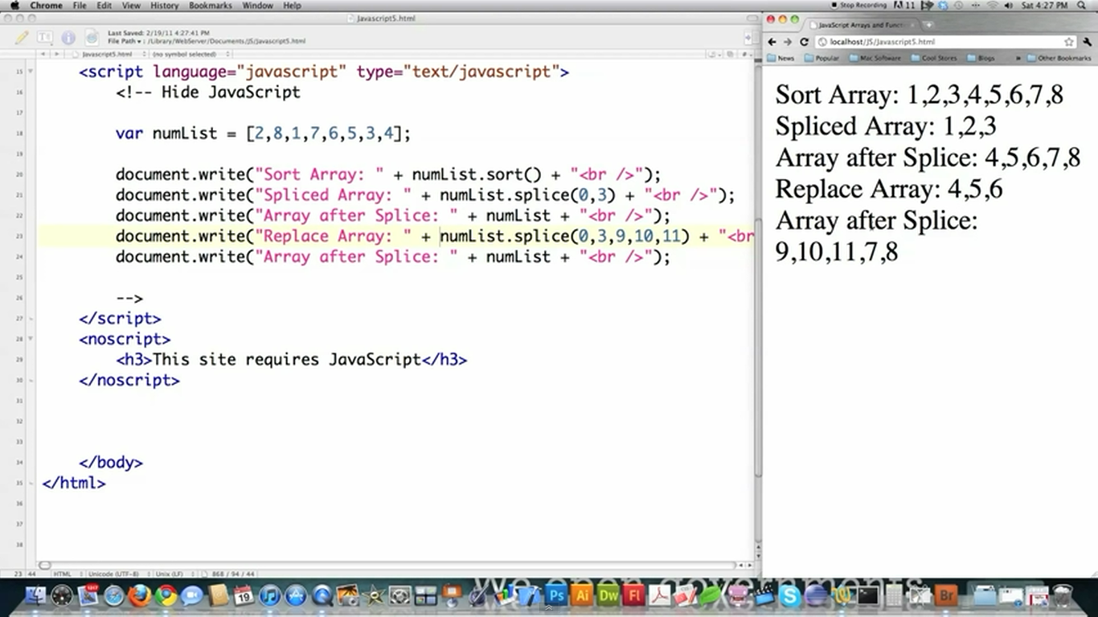


Slide 19
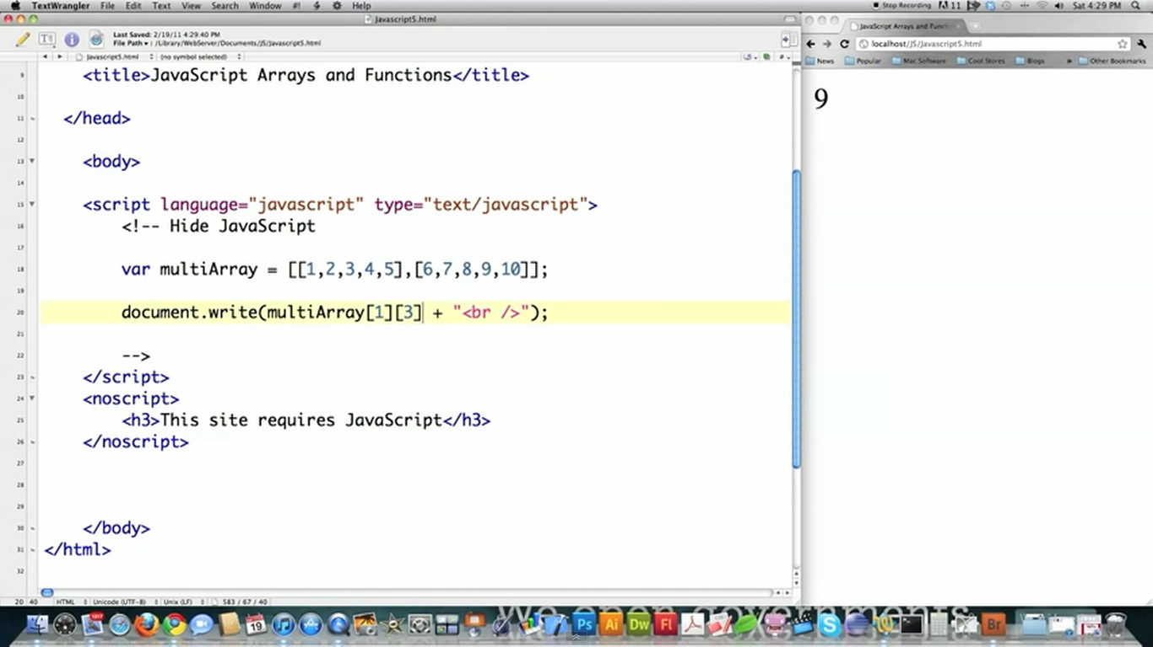

Slide 20
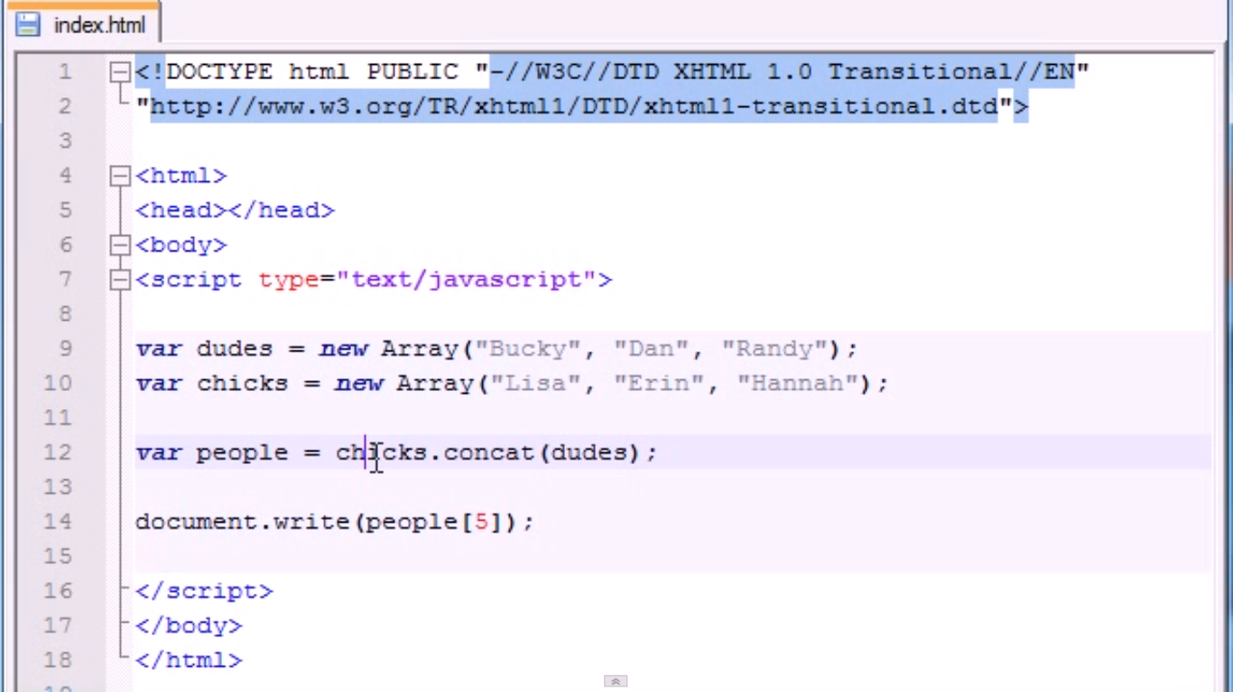
Concatenate Array

Slide 21
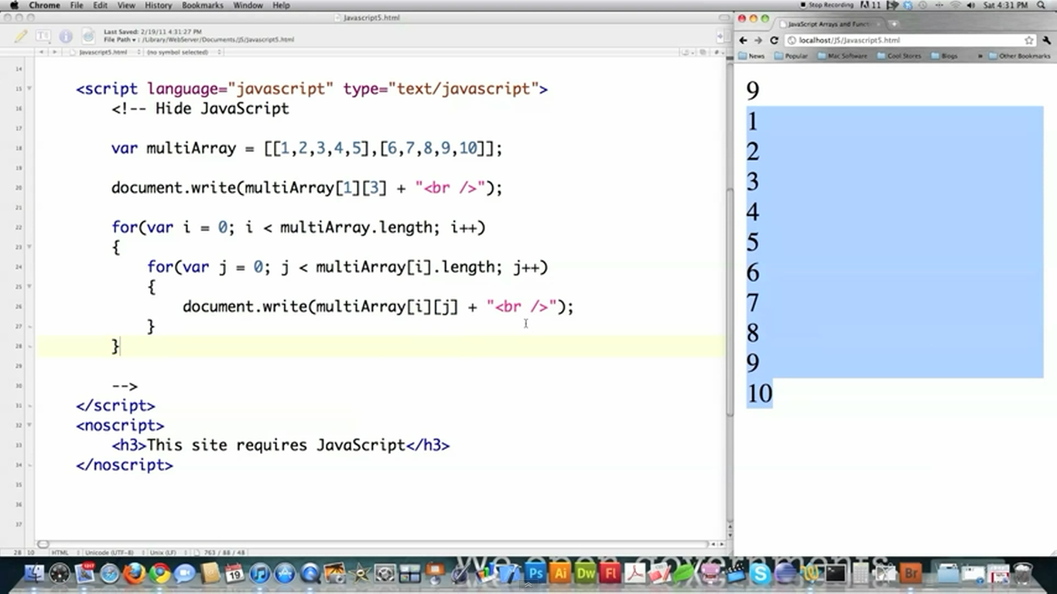

Slide 22
Document Object Model (DOM)
The Document Object Model is a platform- and language-neutral interface that will allow programs and scripts to dynamically access and update the content, structure and style of documents. The document can be further processed and the results of that processing can be incorporated back into the presented page. This is an overview of DOM-related materials here at W3C and around the web.
The Document Object Model (DOM) is a programming API for HTML and XML documents. It defines the logical structure of documents and the way a document is accessed and manipulated. In the DOM specification, the term "document" is used in the broad sense - increasingly, XML is being used as a way of representing many different kinds of information that may be stored in diverse systems, and much of this would traditionally be seen as data rather than as documents. Nevertheless, XML presents this data as documents, and the DOM may be used to manage this data.

Slide 23

The HTML DOM (Document Object Model)
When a web page is loaded, the browser creates a Document Object Model of the page.
The HTML DOM model is constructed as a tree of Objects:

Slide 24
Java Script Roll with DOM
With the object model, JavaScript gets all the power it needs to create dynamic HTML:
JavaScript can change all the HTML elements in the page
JavaScript can change all the HTML attributes in the page
JavaScript can change all the CSS styles in the page
JavaScript can remove existing HTML elements and attributes
JavaScript can add new HTML elements and attributes
JavaScript can react to all existing HTML events in the page
JavaScript can create new HTML events in the page

Slide 25
Why DOM
"Dynamic HTML" is a term used by some vendors to describe the combination of HTML, style sheets and scripts that allows documents to be animated. The W3C has received several submissions from members companies on the way in which the object model of HTML documents should be exposed to scripts. These submissions do not propose any new HTML tags or style sheet technology. The W3C DOM Activity is working hard to make sure interoperable and scripting-language neutral solutions are agreed upon.

Slide 26
The Document Object Model is a programming API for documents. The object model itself closely resembles the structure of the documents it models. For instance, consider this table, taken from an HTML document:
<TABLE>
<ROWS>
<TR>
<TD>Shady Grove</TD>
<TD>Aeolian</TD>
</TR>
<TR> <TD>Over the River, Charlie</TD>
<TD>Dorian</TD>
</TR>
</ROWS>
</TABLE>

Slide 27
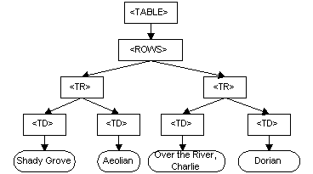
The Document Object Model represents this table like this:
DOM representation of the example table

Slide 28
The name "Document Object Model" was chosen because it is an "object model" is used in the traditional object oriented design sense: documents are modeled using objects, and the model encompasses not only the structure of a document, but also the behavior of a document and the objects of which it is composed. In other words, the nodes in the above diagram do not represent a data structure, they represent objects, which have functions and identity. As an object model, the Document Object Model identifies:

Slide 29
Example
The following example changes the content (the innerHTML) of the <p> element with id="demo":
  <html>
  <body>
  <p id="demo"></p>
  <script>
  document.getElementById("demo").innerHTML = "Hello World!";
  </script>
  </body>
  </html>

Slide 30
<!DOCTYPE html>
<html>
<body>
<h1>What Can JavaScript Do?</h1>
<p id="demo">JavaScript can change HTML content.</p>
<button type="button"
onclick="document.getElementById('demo').innerHTML = 'Hello JavaScript!'">
Click Me!</button>
</body>
</html>

Slide 31
<!DOCTYPE html>
<html>
<body>
<p>Creating a JavaScript Variable.</p>
<p id="demo"></p>
<script>
var car = "Fiat";
document.getElementById("demo").innerHTML = car;
</script>
</body>
</html>

Slide 32
JAVA SCRIPT
The getElementById Method
The most common way to access an HTML element is to use the id of the element.
In the example above the getElementById method used id="demo" to find the element.
The innerHTML Property
The easiest way to get the content of an element is by using the innerHTML property.
The innerHTML property is useful for getting or replacing the content of HTML elements.

Slide 33
JavaScript Events
HTML events are "things" that happen to HTML elements.
When JavaScript is used in HTML pages, JavaScript can "react" on these events.
HTML Events
An HTML event can be something the browser does, or something a user does.
Here are some examples of HTML events:
An HTML web page has finished loading
An HTML input field was changed
An HTML button was clicked

Slide 34
JavaScript Events
Often, when events happen, you may want to do something.
JavaScript lets you execute code when events are detected.
HTML allows event handler attributes, with JavaScript code, to be added to HTML elements.
With single quotes:
<some-HTML-element some-event='some JavaScript'>
With double quotes:
<some-HTML-element some-event="some JavaScript">

Slide 35
Example
<!DOCTYPE html>
<html>
<body>
<button onclick="getElementById('demo').innerHTML=Date()">The time is?</button>
<p id="demo"></p>
</body>
</html>

Slide 36
Onclick Event
<!DOCTYPE html>
<html>
<body>
<button onclick="this.innerHTML=Date()">The time is?</button>
</body>
</html>

Slide 37
HTML EVENTS
Common HTML Events
Here is a list of some common HTML events:
Event | Description
onchange | An HTML element has been changed
onclick | The user clicks an HTML element
onmouseover | The user moves the mouse over an HTML element
onmouseout | The user moves the mouse away from an HTML element
onkeydown | The user pushes a keyboard key
onload | The browser has finished loading the page

Slide 38
What can JavaScript Do?
Event handlers can be used to handle, and verify, user input, user actions, and browser actions:
Things that should be done every time a page loads
Things that should be done when the page is closed
Action that should be performed when a user clicks a button
Content that should be verified when a user input data
And more ...
Many different methods can be used to let JavaScript work with events:
HTML event attributes can execute JavaScript code directly
HTML event attributes can call JavaScript functions
You can assign your own event handler functions to HTML elements
You can prevent events from being sent or being handled

Slide 39
JavaScript HTML DOM Events Examples
Input Events
onblur - When a user leaves an input field
onchange - When a user changes the content of an input field
onchange - When a user selects a dropdown value
onfocus - When an input field gets focus
onselect - When input text is selected
onsubmit - When a user clicks the submit button
onreset - When a user clicks the reset button
onkeydown - When a user is pressing/holding down a key
onkeypress - When a user is pressing/holding down a key
onkeyup - When the user releases a key
onkeyup - When the user releases a key
onkeydown vs onkeyup - Both

Slide 40
Mouse Events
onmouseover/onmouseout - When the mouse passes over an element
onmousedown/onmouseup - When pressing/releasing a mouse button
onmousedown - When mouse is clicked: Alert which element
onmousedown - When mouse is clicked: Alert which button
onmousemove/onmouseout - When moving the mouse pointer over/out of an image
onmouseover/onmouseout - When moving the mouse over/out of an image
onmouseover an image map
Click Events
Acting to the onclick event
onclick - When button is clicked
ondblclick - When a text is double-clicked

Slide 41
Java Script Events
Load Events
onload - When the page has been loaded
onload - When an image has been loaded
onerror - When an error occurs when loading an image
onunload - When the browser closes the document
onresize - When the browser window is resized
Others
What is the keycode of the key pressed?
What are the coordinates of the cursor?
What are the coordinates of the cursor, relative to the screen?
Was the shift key pressed?
Which event type occurred?

Slide 42
Java Script Window Object
Open a new window when clicking on a button
Open a new window and control its appearance
Blur and Focus a new window
Close the new window
Checks whether the new window has been closed or not
Write some text to the source (parent) window
Move the new window relative to its current position
Move the new window to the specified position
Print the current page
Resize a window by the specified pixels
Resize a window to a specified size
Scroll the content by the specified number of pixels
Scroll the content to a specified position

Slide 43
Creating a JavaScript Object
<!DOCTYPE html>
<html>
<body>
<p>Creating a JavaScript Object.</p>
<p id="demo"></p>
<script>
var person = {
firstName : "John",
lastName : "Doe",
age : 50,
eyeColor : "blue"
};
document.getElementById("demo").innerHTML =
person.firstName + " is " + person.age + " years old.";
</script>
</body>
</html>

Slide 44
Creating and using an object method
<!DOCTYPE html>
<html>
<body>
<p>Creating and using an object method.</p>
<p>An object method is a function definition, stored as a property value.</p>
<p id="demo"></p>
<script>
var person = {
firstName: "John",
lastName : "Doe",
id : 5566,
fullName : function(c) {
return this.firstName + " " + this.lastName;
}
};
document.getElementById("demo").innerHTML = person.fullName();
</script>
</body>
</html>

Slide 45
Open a new window when clicking on a button
<!DOCTYPE html>
<html>
<head>
<script>
function openWin() {
window.open("http://www.w3schools.com");
}
</script>
</head>
<body>
<form>
<input type="button" value="Open Window" onclick="openWin()">
</form>
</body>
</html>

Slide 46
Open a new window and control its appearance
<!DOCTYPE html>
<html>
<head>
<script>
function openWin() {
window.open("http://www.w3schools.com","_blank","toolbar=yes, location=yes, directories=no, status=no, menubar=yes, scrollbars=yes, resizable=no, copyhistory=yes, width=400, height=400");
}
</script>
</head>
<body>
<form>
<input type="button" value="Open Window" onclick="openWin()">
</form>
</body>
</html>

Slide 47
_x000b_Close the new window
<!DOCTYPE html>
<html>
<head>
<script>
var myWindow;
function openWin() {
myWindow = window.open("", "", "width=400, height=200");
}
function closeWin() {
myWindow.close();
}
</script>
</head>
<body>
<input type="button" value="Open 'myWindow'" onclick="openWin()" />
<input type="button" value="Close 'myWindow'" onclick="closeWin()" />
</body>
</html>

Slide 48
_x000b_Move the new window to the specified position
<!DOCTYPE html>
<html>
<head>
<script>
var myWindow;
function openWin() {
myWindow=window.open("", "", "width=400, height=200");
}
function moveWin() {
myWindow.moveTo(300, 0);
myWindow.focus();
}
</script>
</head>
<body>
<input type="button" value="Open myWindow" onclick="openWin()" />
<br><br>
<input type="button" value="Move myWindow" onclick="moveWin()" />
</body>
</html>

Slide 49
Print the current page
<!DOCTYPE html>
<html>
<head>
<script>
function printPage() {
window.print();
}
</script>
</head>
<body>
<input type="button" value="Print this page" onclick="printPage()" />
</body>
</html>

Slide 50
<!DOCTYPE html>
<html>
<head>
<script>
var w;
function openwindow() {
w = window.open('','', 'width=100,height=100');
w.focus();
}
function myFunction() {
w.resizeTo(500,500);
w.focus();
}
</script>
</head>
<body>
<button onclick="openwindow()">Create window</button>
<button onclick="myFunction()">Resize window</button>
</body>
</html>

Slide 51
JAVASCRIPT LOCAL VARIABLE
<!DOCTYPE html>
<html>
<body>
<p>A local variable can only be accessed from within the function where it was declared.</p>
<p id="demo"></p>
<script>
myFunction();
document.getElementById("demo").innerHTML =
"I can display " + typeof carName;
function myFunction() {
var carName = "Volvo";
}
</script>
</body>
</html>

Slide 52
JAVASCRIPT GLOBAL VARIABLE
<!DOCTYPE html>
<html>
<body>
<p>A GLOBAL variable can be accessed from any script or function.</p>
<p id="demo"></p>
<script>
var carName = "Volvo";
myFunction();
function myFunction() {
document.getElementById("demo").innerHTML =
"I can display " + carName;
}
</script>
</body>
</html>

Slide 53
AUTOMATICALLY GLOBAL
<!DOCTYPE html>
<html>
<body>
<p>
If you assign a value to a variable that has not been declared,
it will automatically become a GLOBAL variable:
</p>
<p id="demo"></p>
<script>
myFunction();
document.getElementById("demo").innerHTML =
"I can display " + carName;
function myFunction() {
carName = "Volvo";
}
</script>
</body>
</html>

Slide 54
JavaScript Objects
In JavaScript, objects are king. If you understand objects, you understand JavaScript.
In JavaScript, almost "everything" is an object.
• Booleans can be objects (or primitive data treated as objects)
• Numbers can be objects (or primitive data treated as objects)
• Strings can be objects (or primitive data treated as objects)
• Dates are always objects
• Maths are always objects
• Regular expressions are always objects
• Arrays are always objects
• Functions are always objects
• Objects are objects
In JavaScript, all values, except primitive values, are objects.
Primitive values are: strings ("John Doe"), numbers (3.14), true, false, null, and undefined.

Slide 55
Javascript Testing Technique
<!DOCTYPE html>
<html>
<body>
<p>The test() method returns true if it finds a match, otherwise it returns false.</p>
<p>Click the button to search a string for the character "e".</p>
<button onclick="myFunction()">Try it</button>
<p id="demo"></p>
<script>
function myFunction() {
var str = "The best things in life are free";
var patt = new RegExp("e");
var res = patt.test(str);
document.getElementById("demo").innerHTML = res;
}
</script>
</body>
</html>

Slide 56
Definition and Usage
The test() method tests for a match in a string.
This method returns true if it finds a match, otherwise it returns false.
Browser Support
The test() method is supported in all major browsers.
Syntax
RegExpObject.test(string)

Slide 58
Java Script Object
Screen Object
The visitor's screen: Width
The visitor's screen: Height
The visitor's screen: Available Width
The visitor's screen: Available Height
The visitor's screen: Color Depth
The visitor's screen: Pixel Depth
Screen explained
Location Object
Return the hostname and port of the current URL
Return the entire URL of the current page
Return the path name of the current URL
Return the protocol portion of the current URL
Load a new document
Replace the current document
Break out of a frame

Slide 59
Web Resources
www.javascript.com
www.iboost.com/build/programming/js/tutorial/885.htm
www.javascriptsearch.com
www.a1javascripts.com

